Slide 1

Optimización Complementaria:
Mixed Complementarity models
Felipe Feijoo, Ph.D.
Oficina: EII, IBC 6-7.
Email: Felipe.Feijoo@pucv.cl

Slide 2
Bertrand model of duopoly
  Consider two firms competing in terms of the price offered of a product.
  Each firms sells a product that is a substitute of the other firm’s product (differentiated products)
  Each firm must decide the price at which the product is offered.
  If Firm 1 and Firm 2 choose P1 and P2 as the prices, then the demand for product “i” is given by
  (for now) Assume that there are not fixed costs and that the marginal cost are constant at C, with C<a
  Both firms choose their prices simultaneously.
$$q_{i}\left(q_{i},q_{j}\right)=a −p_{i}+bp_{j} with b>0.$$

Slide 3
What is optimization? What types have you worked on?
  What is optimization?
  What classes of problems you know?
    Unconstrained optimization (examples of Cournot in class)
    Constrained optimization
      Linear programs
      Quadratic programs
      Other nonlinear programs
        Convex vs non convex
          Local vs global
        SOCP, SDP, Chance constraints and other stochastic models,
        Many more

Slide 4

What is optimization? What types have you worked on?
  Maximize or minimize one or more functions subject to equations and inequalities (constrained optimization)
Objective Function
$$\min{ }f(x) \\ s.t. \\ g_{i}(x)≤0,i=1,2,…,m \\ h_{j}(x)=0,j=1,2,…,p \\ with \\ f:R^{n}→R,g_{i}:R^{n}→R,h_{j}:R^{n}→R$$
Feasible Region
Want to motivate the Karush-Kuhn-Tucker (KKT) optimality conditions for this nonlinear program

Slide 5
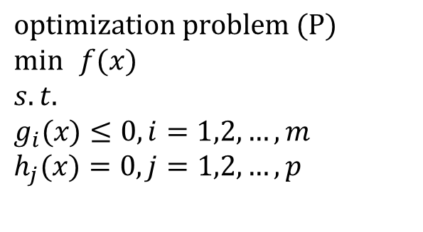
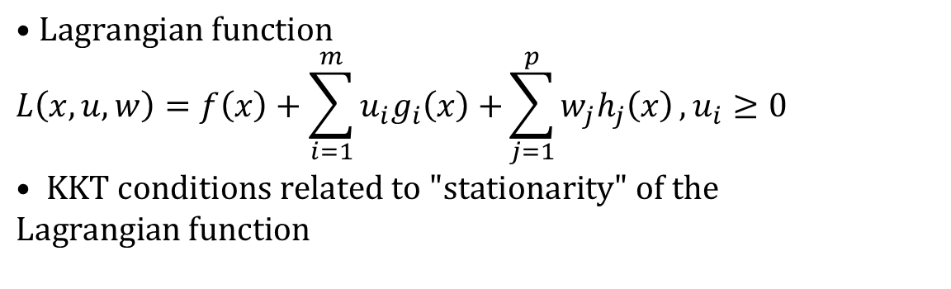
Non linear programs of interest
For the problem (P), the Lagrangian function is as follows
$$\text{optimization} \text{problem} (P) \\ \min{ }f(x) \\ s.t. \\ g_{i}(x)≤0,i=1,2,…,m \\ h_{j}(x)=0,j=1,2,…,p$$
$$•Lagrangian function \\ L\left(x,u,w\right)=f\left(x\right)+\sum_{i=1}^{m}{u_{i}g_{i}\left(x\right)+}\sum_{j=1}^{p}{w_{j}h_{j}\left(x\right)},u_{i}≥0 \\ • KKT conditions related to "stationarity" of the \\ Lagrangian function$$

Slide 6
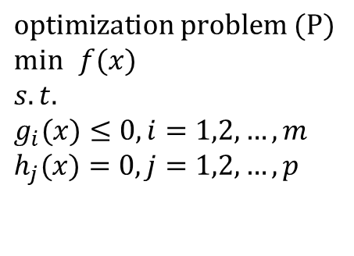
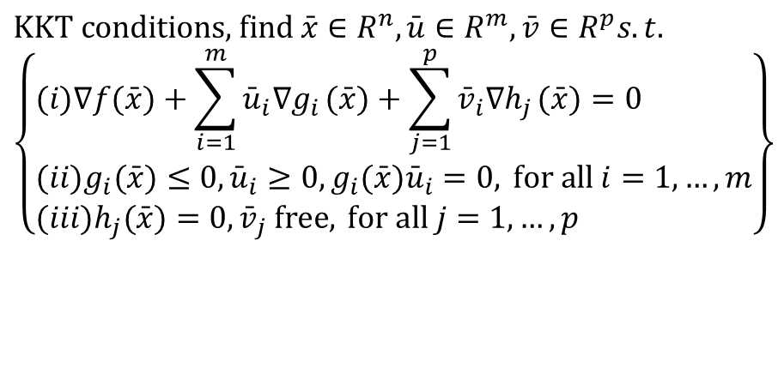
Non linear programs of interest
For the problem (P), its KKT conditions are given as:
$$\text{optimization} \text{problem} (P) \\ \min{ }f(x) \\ s.t. \\ g_{i}(x)≤0,i=1,2,…,m \\ h_{j}(x)=0,j=1,2,…,p$$
$$\text{KKT} \text{conditions}\text{, }\text{find} \bar{x}∈R^{n},\bar{u}∈R^{m},\bar{v}∈R^{p}s.t. \\ \left\{\begin{aligned}&(i)∇f(\bar{x})+\sum_{i=1}^{m}{{\bar{u}}_{i}∇g_{i}}(\bar{x})+\sum_{j=1}^{p}{{\bar{v}}_{i}∇h_{j}}(\bar{x})=0 \\ &(ii)g_{i}(\bar{x})≤0,{\bar{u}}_{i}≥0,g_{i}(\bar{x}){\bar{u}}_{i}=0, \text{for} \text{all} i=1,…,m \\ &(iii)h_{j}(\bar{x})=0,{\bar{v}}_{j} \text{free}, \text{for} \text{all} j=1,…,p\end{aligned}\right\}$$
(i) is stationarity
(ii) is feasibility and complementarity for the inequalities
(iii) is feasibility for the equalities

Slide 7
Eq. Problems expressed as Complementarity problems (MCP or NCP)
Notes:
The students have a copy of this file. (3,3) is also a solution.

Slide 8
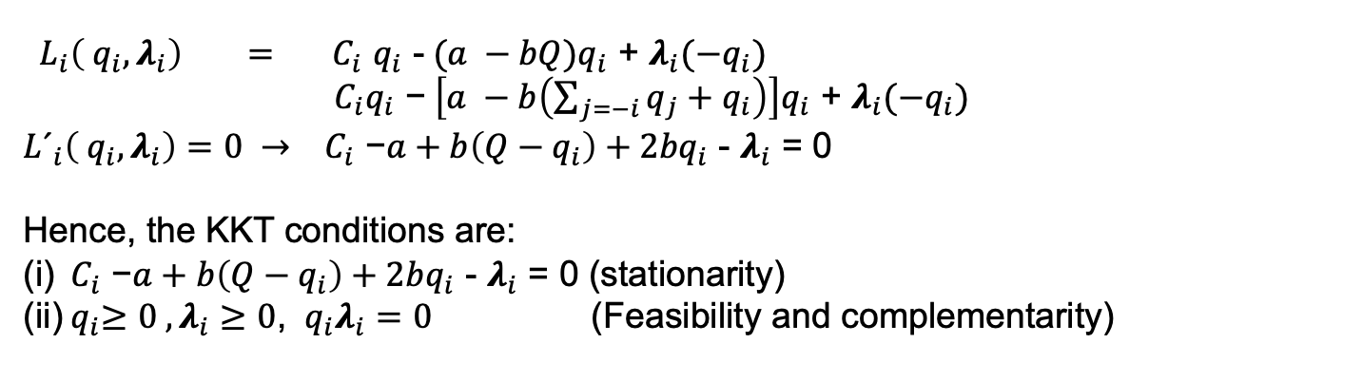

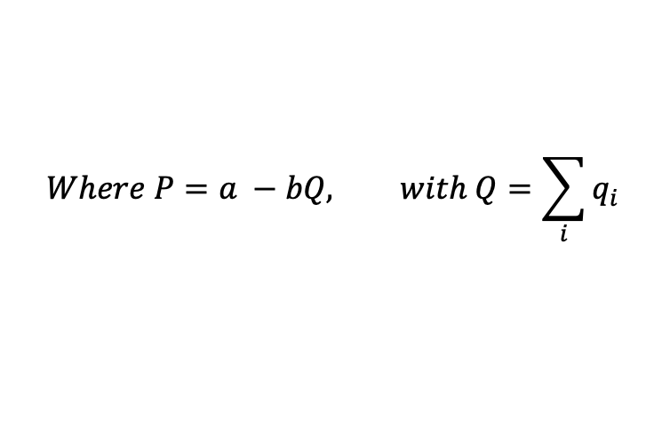
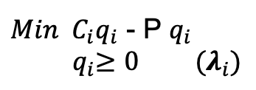
Consider the case of Cournot players
$$\text{O}\text{ptimization} \text{problem} \left(P\right) for each Cournot player i in I.$$
$$Where P=a −bQ, with Q=\sum_{i}{q_{i}}$$
$Min{ C}_{i}q_{i}$ - P $q_{i}$
$${ q}_{i}≥0 (λ_{i})$$
Then the Lagrange function for player i is as follows:
${ L}_{i}({ q}_{i},λ_{i}) ={ C}_{i}q_{i}\text{ - }\text{P} q_{i}$ + $λ_{i}(−q_{i})$
Therefore, the First Order Conditions (FOC), or KKT for this problems are:
${ L}_{i}\left({ q}_{i},λ_{i}\right) {= C}_{i}q_{i}\text{ -} (a −bQ)q_{i}$ + $λ_{i}(−q_{i})$
${ C}_{i}q_{i}\text{ −} \left[a −b\left(\sum_{j=−i}{q_{j}+q_{i}}\right)\right]q_{i}$ + $λ_{i}(−q_{i})$
${L´}_{i}\left({ q}_{i},λ_{i}\right)=0 → { C}_{i}\text{ −}a+b\left(Q−q_{i}\right){+ 2bq}_{i}$ - $λ_{i}$ = 0
Hence, the KKT conditions are:
(i)${ C}_{i}\text{ −}a+b\left(Q−q_{i}\right){+ 2bq}_{i}$ - $λ_{i}$ = 0 (stationarity)
(ii)${ q}_{i}≥0 , λ_{i}≥0$, ${ q}_{i}λ_{i}=0$ (Feasibility and complementarity)

Slide 9



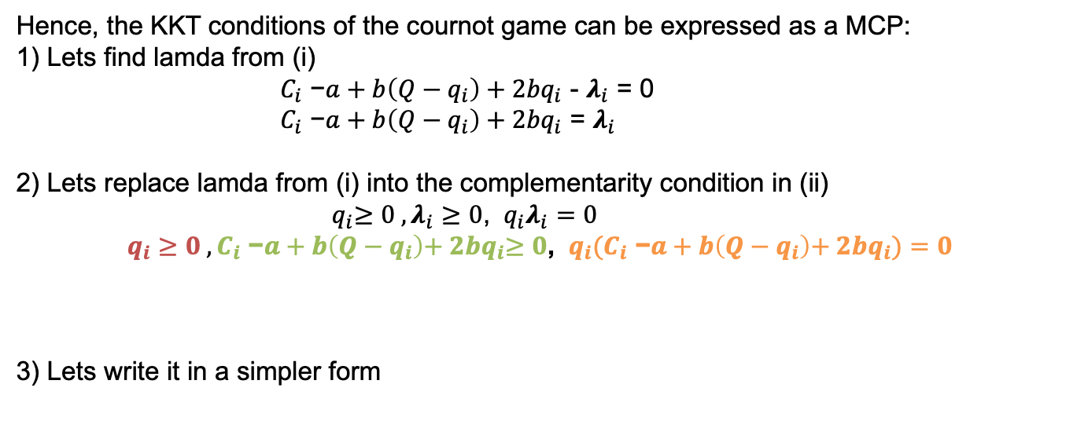
Cournot game as MCP (NCP)
Hence, the KKT conditions of the cournot game can be expressed as a MCP:
1) Lets find lamda from (i)
${ C}_{i}\text{ −}a+b\left(Q−q_{i}\right){+ 2bq}_{i}$ - $λ_{i}$ = 0
${ C}_{i}\text{ −}a+b\left(Q−q_{i}\right){+ 2bq}_{i}$ = $λ_{i}$
2) Lets replace lamda from (i) into the complementarity condition in (ii)
${ q}_{i}≥0 , λ_{i}≥0$, ${ q}_{i}λ_{i}=0$
$q_{i}≥0 ,C_{i}\text{ −}a+b\left(Q−q_{i}\right){+ 2bq}_{i}≥0$, ${ q}_{i}(C_{i}\text{ −}a+b\left(Q−q_{i}\right){+ 2bq}_{i})=0$
3) Lets write it in a simpler form
$x_{i}$>= 0
$F_{i}(x)$ >= 0
${x_{i}F}_{i}(x)$ = 0
$0≤x_{i}⊥F_{i}(x)\text{≥}\text{0}$ → $0≤q_{i}⊥C_{i}\text{ −}a+b\left(Q−q_{i}\right){+ 2bq}_{i}\text{≥}\text{0}$
Notes:
The students have a copy of this file. (3,3) is also a solution.

Slide 10
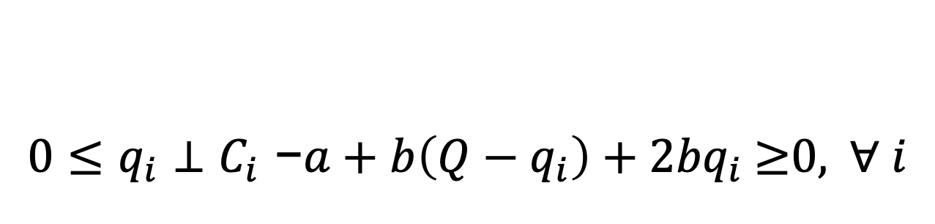
Cournot game as MCP (NCP)
Can you code the following MCP in GAMS?
$$0≤q_{i}⊥C_{i}\text{ −}a+b\left(Q−q_{i}\right){+ 2bq}_{i}\text{≥}\text{0}\text{, } ∀ i$$
Notes:
The students have a copy of this file. (3,3) is also a solution.

Slide 11
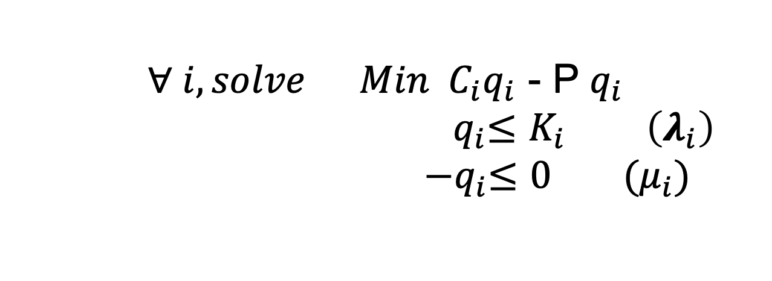
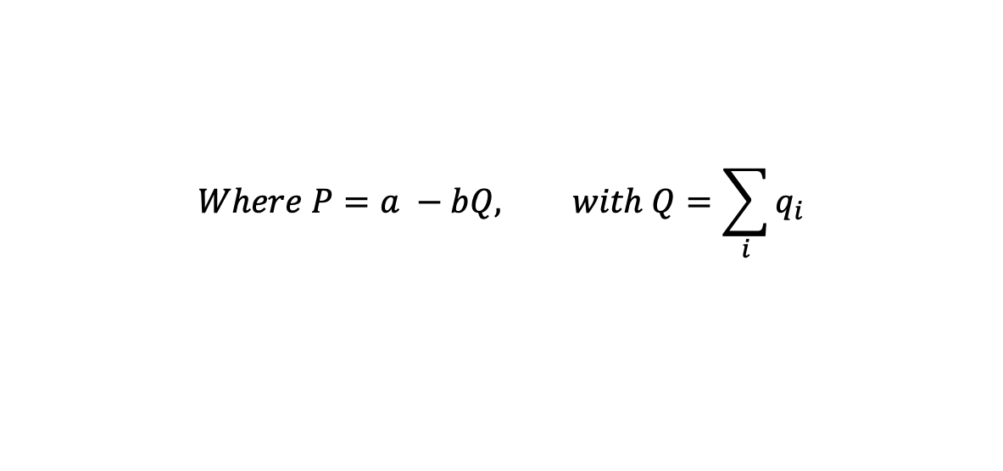
Cournot game as MCP (NCP)
Cournot game with capacity constraints
$$∀ i, solve Min{ C}_{i}q_{i}\text{ - }\text{P} q_{i}$$
$${ q}_{i}≤K_{i} \left(λ_{i}\right)$$
$${ −q}_{i}≤0 (μ_{i})$$
$$Where P=a −bQ, with Q=\sum_{i}{q_{i}}$$
Notes:
The students have a copy of this file. (3,3) is also a solution.

Slide 12
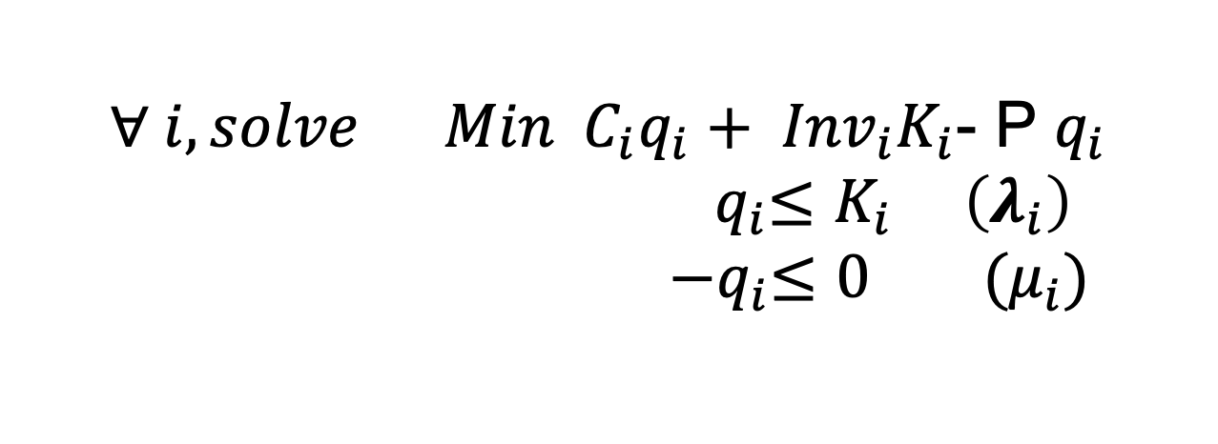
Cournot game as MCP (NCP)
Cournot game with capacity investment
$$∀ i, solve Min{ C}_{i}q_{i} \text{+}{ Inv}_{i}K_{i}\text{- }\text{P} q_{i}$$
$${ q}_{i}≤K_{i} \left(λ_{i}\right)$$
$${ −q}_{i}≤0 (μ_{i})$$
$$Where P=a −bQ, with Q=\sum_{i}{q_{i}}$$
Notes:
The students have a copy of this file. (3,3) is also a solution.

